Slide 1








Presentation on
Cache Memory
Presented to
Dr. Md. Fokhray Hossain
Professor
Department of Computer Science and Engineering
Daffodil international university

Slide 2

PRESENTED BY
James Amin John
Id:0242310005101596
Section:64_A
Course Code:CSE_413
Course Title: Computer Architecture and Organization
Department of CSE
Daffodil International University

Slide 3






INTRODUCTION
Cache memory is a small and very fast type of memory placed between the CPU and RAM. It stores the data and instructions that the CPU uses often . This helps the CPU work faster because it doesn’t need to fetch everything from the slower main memory every time, acting like a quick helper between the CPU and RAM.

Slide 4







There are two types of cache memory:
Internal cache memory
External cache memory
Internal cache : built inside the CPU, includes L1 and usually L2
External cache :outside the CPU core but on the chip, includes older L2 and L3
Internal is the fastest, while external is slower but still faster than RAM.

Slide 5






CACHE WRITE POLICIES
There are two main types:
1.Write-Back: Data is written only to the cache at first. The updated data is sent to the main memory later, which makes it faster but needs extra steps to keep memory accurate.
2.Write-Through: Data is written to both the cache and main memory at the same time. This keeps everything up-to-date but can be slower because it writes twice.

Slide 6







x=100
Write Back
Write Through
Before
After
Before
After
x=100
x= x+ 100
x=100
Processor
x= x+ 100
Processor
x=100
Cache
x=200
x=100
Cache
x=200
Main Memory
x=200
x=100
x=100
Main Memory
x=100

Slide 7




Cache Miss vs Cache Hit
Cache Hit:
Data requested by CPU is found in the cache.
Access is very fast.
Improves CPU performance.
Cache Miss:
Data requested by CPU is not in the cache.
Data must be fetched from slower RAM.
Slows down performance.

Slide 8

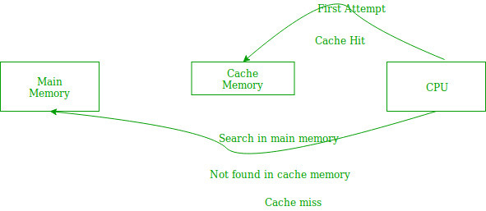

Cache Miss vs Cache Hit

Slide 9



Advantages and Disadvantages of cache memory
Advantages:
Makes the CPU faster by reducing data access time.
Stores frequently used data for quick use.
Improves overall system performance.
Disadvantages:
Expensive compared to RAM.
Limited in size (small storage).
Adds complexity to the system design.

Slide 10

Conclusion
Cache memory helps the CPU work faster by keeping data it uses often. If the data is already in the cache (cache hit), the CPU can use it quickly. If it is not there (cache miss), the CPU must get it from RAM, which is slower. Using cache well makes the computer run faster and with fewer delays.

Slide 11
Reference
ScienceDirect:Cache Memory
GeeksforGeeks:Locality of Reference and Cache Operation in Cache Memory
Hennessy, J. L., & Patterson, D. A. (2017).
Computer Architecture: A Quantitative Approach (6th ed.). Morgan Kaufmann.
Computer Organization and Architecture (11th ed.). Pearson Education.
Mano, M. M., & Ciletti, M. D. (2012). Digital Design (5th ed.). Pearson Education

Slide 12


THANK YOU

